Slide 1
Finding the right Chicago community
Capstone Project
Rajesh – 09/2019

Slide 2
Introduction
A friend of mine is a good cook and moving from another city to Chicago with a plan to open a restaurant. He asked my help to find a best community that fits his needs. His requirements are: The place and surroundings should have sizable middle age people and good employment rate he is going to open a Mexican restaurant so there should be a sizable Latino and Hispanic community in the neighborhood but not with many Mexican restaurants around. Also his restaurant price range is going to be Moderate to High so the community income should be decent to afford.

Slide 3
Datasets
I need the following datasets:
Communities
Latino and Hispanic % in community
Average Income of the community
% of people between 15 and 65
Neighboring communities
Employment rates
Community geocodes
Mexican restaurants in the community and their price range

Slide 4
Datasets Cont.
After researching online, I found the following:
Census data to help with communities and demographics details:
https://datahub.cmap.illinois.gov/dataset/2010-census-data-summarized-to-chicago-community-areas
Socio-economic data of Chicago communities:
https://data.cityofchicago.org/Health-Human-Services/Census-Data-Selected-socioeconomic-indicators-in-C/kn9c-c2s2
Created dataset: Chicago communities Latitude and Longitude information:
https://github.com/LRT-YASH/TestDSRepo/blob/master/Chicago_Lat_Long.csv
Finally Foursquare API for Mexican restaurants in each community.

Slide 5
Data Cleansing and adding features
All the datasets needed a lot of cleansing, some of the activities include:
Removal of unnecessary features from all datasets
Removal of unnecessary row from socio-economic dataset
Added columns:
Rank of community by Hispanic and Latino Population %
Rank of community by Income
Rank of community by Age group
Also added number of Mexican restaurants in the community

Slide 6
Model
Clustering is considered the best fit for the given requirement
Communities are clustered based on the factors listed in the previous slide
K-Means and Hierarchical methods are used and compared

Slide 7
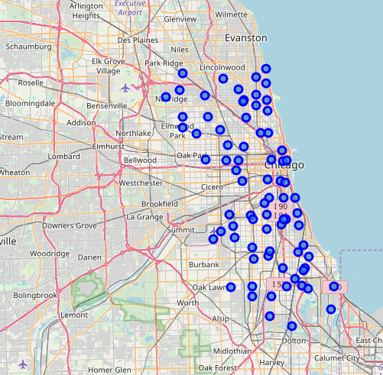
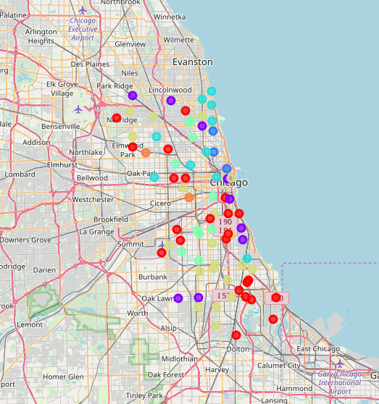
Results
Communities before and after clustering:

Slide 8
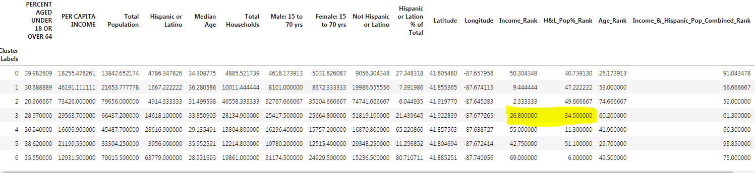
Results Cont.
The mean of income rank and Hispanic & Latino population % rank gives us an idea of the cluster that best fits the need

Slide 9
Artifacts
Notebook:
https://github.com/LRT-YASH/TestDSRepo/blob/master/Week5_Final.ipynb
Report
https://github.com/LRT-YASH/TestDSRepo/blob/master/Finding%20a%20Chicago%20community%20to%20open%20a%20Mexican%20Restaurant.docx

